Slide 1
Nashville City Cemetery
Notes:
Today I am presenting my data on something that I found interesting about the Nashville City Cemetery project

Slide 2

Overview
Introduction
Civil War Aftermath
Disease Outbreaks
Social and Economic Factors
Conclusion
Notes:
This slide just shows an overview of what will be discussed in today’s presentation
I will start with an introduction of what information I thought was interesting and then go deeper into

Slide 3
Introduction
Spike of deaths between 1865-1866
Civil War
Disease
Cholera
Smallpox
Poor sanitation
Economic hardships
Impact of the civil war on Nashville, TN
Figure 1: This chart shows the number of burials per year between 1846 and 1978
Notes:
When completing the project I noticed a spike of deaths in Nashville between 1865-1866, which led me to research the cause.
What I found was that this spike was due to the impact of the civil war, and the increase in diseases such a cholera and smallpox.
There was also poor sanitation and economic hardships that further led to this spike.

Slide 4
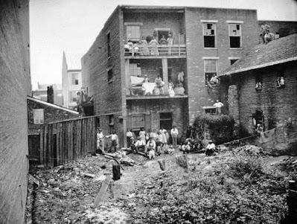
Civil War Aftermath
The Battle of Nashville
December 15th-16th 1864
Over 30,000 soldiers
The goal was to take back Nashville
The Outcome
Deaths
Wounded veterans
Overwhelmed medical Facilities
Figure 2: Hospital Number 19, Nashville, TN
Notes:
The Battle of Nashville took place between December 15th and 16th 1864 under the leadership of Lieut. General John B. Hood.
With a following of 30,000 soldiers, the goal was to take back Nashville from the occupying Federal Army
It was believed that over 4500 soldiers were either killed, wounded, or captured in this battle.
As a result of wounded and dying men on both sides of the battle, hospitals were overwhelmed by the influx of individuals. The overcrowded hospitals were reported to have blood-soaked floors, and the ill and injured had to sometimes wait outside in the cold until a room became available leading to even more deaths.
The image on the right shows hospital number 19, which was overcrowded. As you can see, several men were waiting outside to be seen.

Slide 5
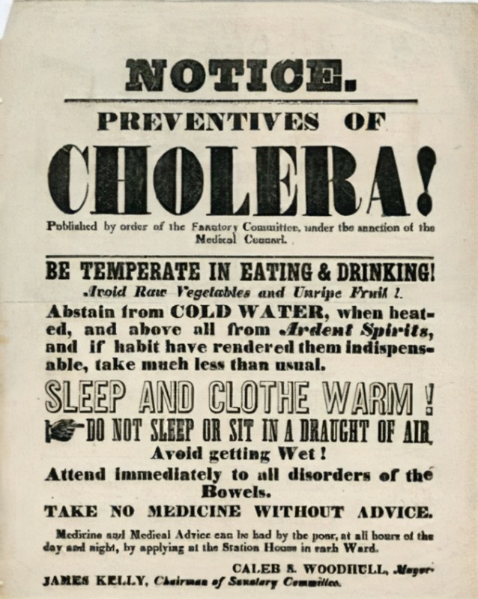
Disease Outbreaks
Post Civil War
Influx of refugees, freed African Americans, and war veterans
Unsanitary conditions
Healthcare system strain
Spread of disease
Notes:
After the civil war, there was an influx of refugees, freed African Americans, and war veterans. This influx contributed to overcrowding in the already unsanitary conditions and aided in the spread of disease.
As mentioned previously in the days after the Battle of Nashville there was already a strain on the healthcare system and with the influx of refugees, preventing outbreaks and the spread of diseases such as cholera and smallpox became even harder

Slide 6
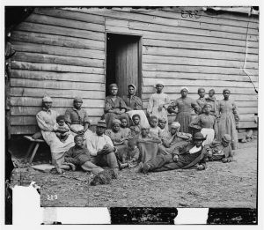
Social and Economic Factors
Racial and Economic Inequality
Freed African Americans
Economic Hardship
Poverty
Nutritious food
Unsanitary living conditions
Public Health Failures
Inconsistent vaccination
Poor Disease management
Notes:
Another contributor to the death spike during this time period was the economic hardships, especially for the freed African Americans.
For freed African Americans, there was a lack of access to basic healthcare, and racism and segregation further limited their ability to access medical treatment, which led to higher mortality rates.
In terms of economic hardships, the South was impacted by the war. This led to many individuals not being able to afford proper healthcare. There was also lack of access to nutritious food, and unsanitary living conditions.
There were also many public health failures that led to a death spike during this time, such as the inconsistent availability of vaccinations for things such as smallpox as well as limited medical knowledge. All of these things made it difficult to treat smallpox or cholera, leading to even more deaths.

Slide 7
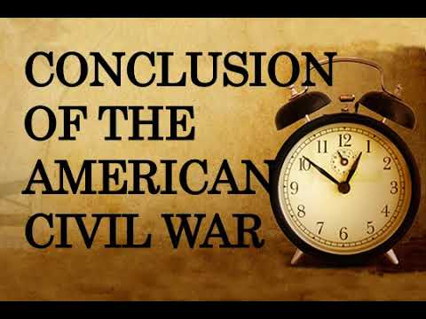
Conclusion
The Big Picture
Civil war toll
Post-War displacement & overcrowding
Destroyed infrastructure
Racial & economic inequality
Healthcare crisis
Economic instability
Notes:
Overall, a combination of war effects, disease outbreaks, and poor public health combined to create a public health disaster, leading to significant loss of life in post-Civil War Nashville.

